Slide 1
PRESENTATION NAME
Company Name

Slide 2
HAPPY NEW YEAR 2016

Slide 3
Motor Unit disorders:
An Overview
Tamer Belal. MD (PhD)
Ass.Prof of Neurology
Mansoura University

Slide 4
Introduction
Motor Unit: a motor neuron and all the muscle fibers it innervates
In the ocular muscles, a motor unit contains only 6 to 10 muscle fibers (some even less), but a motor unit of the gastrocnemius contains as many as 1,800 fibers
Acetylcholine (ACh) is synthesized in the motor nerve terminal and stored in vesicles as packets, or "quanta,”

Slide 5
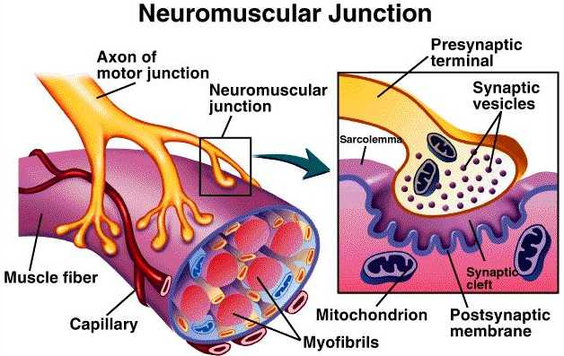
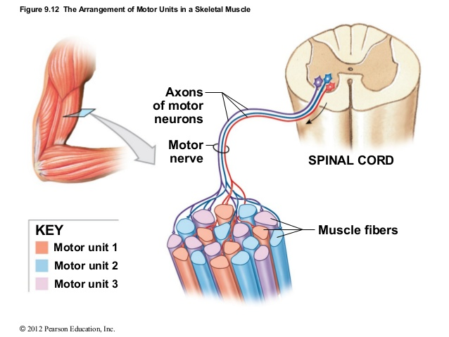
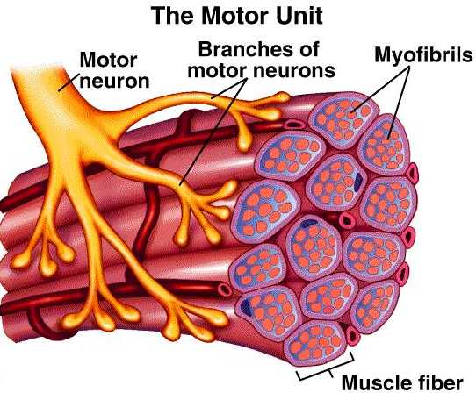

Slide 6
Major Disorders
Level of motor unit | Disorders causing rapidly progressing weakness
Motor neuron | ALS Poliomyelitis, West Nile virus
Peripheral nerve | Guillain-Barre syndrome/AIDP Tick paralysis Diphtheric, porphyric, arsenic neuropathy Shellfish poisoning
Neuromuscular junction | Myasthenia gravis Botulism Lambert-Eaten myasthenic syndrome Hypermagnesemia
Muscle | Acquired: Dermato- and polymyositis, Myoglobinuric myopathy, Hypokalemic paralysis, Toxic myopathy, Acute myopathy of intensive care Genetic disorders: X-linked dystrophies, myotonic dystrophy, acid maltase deficiency, mitochondrial

Slide 7
Muscle Disorders

Slide 8
Muscles are not equally susceptible to disease, despite the apparent similarity of their structure

Slide 9
Classification of Myopathies
Inherited
Muscular dystrophies
Myotonic dystrophy
Congenital myopathies
Channelopathies
Primary metabolic disorders
Congenital myasthenic syndromes
Acquired
Drug and toxin induced
Endocrine
Secondary metabolic
Inflammatory systemic dis.
Paraneoplastic
Myasthenia gravis
Lambert–Eaton myasthenic syndrome

Slide 10
Symptoms of Muscle weakness
Negative | Positive
Weakness | Myalgias
Fatigue | Cramps
Exercise intolerance | Contractures
Muscle atrophy | Myotonia
 | Myoglobinuria

Slide 11
Functional Assessment of Muscle Weakness
Location | Signs or Symptoms of Weakness
Facial | Inability to ‘‘bury eyelashes,’’ ‘‘horizontal smile,’’ inability to whistle
Ocular | Double vision, ptosis, dysconjugate eye movements
Bulbar | Nasal speech, weak cry, nasal regurgitation of liquids, poor suck, difficulty swallowing, recurrent aspiration pneumonia, cough during meals
Neck | Poor head control
Trunk | Scoliosis, lumbar lordosis, protuberant abdomen, difficulty sitting up
Shoulder girdle | Difficulty lifting objects overhead, scapular winging
Forearm/hand | Inability to make a tight fist, finger or wrist drop
Pelvic girdle | Difficulty climbing stairs, waddling gait, Gower’s sign
Leg/foot | Foot drop, inability to walk on heels or toes
Respiratory | Breathlessness,CO2 retention (morning headache,,anorexia and daytime somnelence), Dyspnea,Use of accessory muscles (Paradoxical breathing) and respiratory failure

Slide 12
Clinical Approach
Which ‘‘Negative’’ and/or ‘‘Positive’’ Symptoms and Signs does the Patient
Demonstrate?
Are There Precipitating Factors that Trigger Episodic Weakness or Myotonia?
Is There a Family History of a Myopathic Disorder?
What is the Temporal Evolution?
Are There Associated Systemic Symptoms or Signs?
What is the Distribution of Weakness?

Slide 13
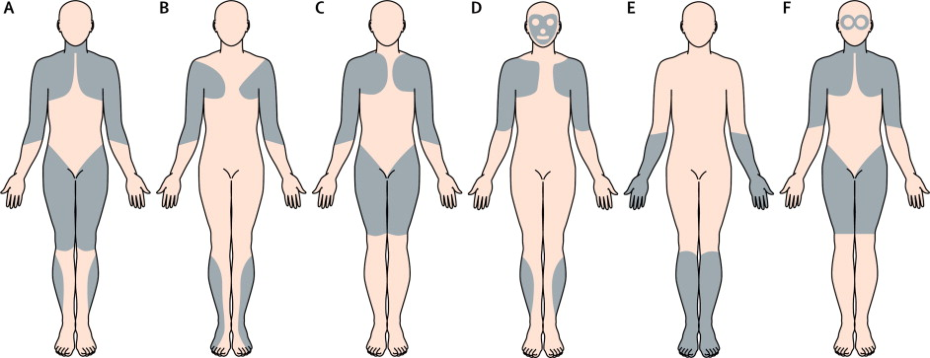
Pattern 1
Proximal Limb-Girdle Weakness
Pattern 2
Distal Weakness
Pattern 3
Proximal Arm/Distal Leg Weakness
(Scapuloperoneal)
Pattern 4
Distal Arm/Proximal Leg Weakness
Pattern 5
Ptosis With or Without Ophthalmoplegia
Pattern 6
Prominent Neck Extensor Weakness

Slide 14
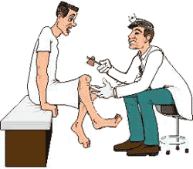
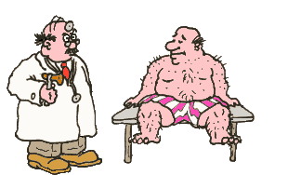
Clinical symptoms and signs suspecting Muscle Disease
Acquired OR Hereditary
Treatable or NO Curative therapy

Slide 15
Expanded MRC Scale for Manual Muscle Testing
Modified MRC Grade | Degree of Strength
5 | Normal power
5- | Equivocal, barely detectable weakness
4+ | Definite but slight weakness
4 | Able to move the joint against combination of gravity and some resistance
4- | Capable of minimal resistance
3+ | Capable of transient resistance but collapses abruptly
3 | Active movement against gravity
3- | Able to move against gravity but not through full range
2 | Able to move with gravity eliminated
1 | Trace contraction
0 | No contraction

Slide 16
Diagnostic Clues for Muscle Weakness
Finding |  |  | Suggested diagnoses
History
 | Abdominal pain; excessive urination; renal stones | Hypercalcemia; hyperparathyroidism
 | Acute weakness with neurologic deficit(s) | Spinal cord injury; stroke
 | Arthralgia; malaise; myalgia; respiratory symptoms | Epstein-Barr virus; HIV; influenza
 | Chronic neck or back pain, with or without sharp shooting pains | Cervical spondylosis; degenerative disc disease
 | Distal weakness | Genetic distal myopathies; inclusion body myositis
 | Dysphagia; rash around eyelids; shortness of breath | Dermatomyositis
 | Easy bruising; emotional lability; obesity | Glucocorticoid excess; steroid-induced myopathy
 | Exercise-provoked weakness | Glycogen and lipid storage diseases; mitochondrial myopathies; myasthenia gravis
 | Family history of myopathy | Hyper- or hypokalemic periodic paralysis; inflammatory disease; muscular dystrophies; rheumatologic disease
 | Heat-induced symptoms; multiple neurologic deficits spread over space and time | Multiple sclerosis
 | Legal problems; memory loss; repeated trauma; sexual dysfunction | Alcoholism
 | Positive medication history | Medication-induced myopathy (esp. anti-retrovirals, statins, steroids)
 | Sexually transmitted disease | HIV; syphilis

Slide 17
Diagnostic Clues for Muscle Weakness
Finding |  |  | Suggested diagnoses
Physical examination
 | Arthritis; malar rash; nephritis |  | Systemic lupus erythematosus
 | Cardiomyopathy |  | Alcohol; amyloid; glycogen storage disease; inflammatory myopathies; muscular dystrophies; sarcoid
 | Dry eyes and mouth; joint inflammation (especially MCP, PIP joints) |  | Rheumatoid arthritis
 | Facial weakness; fatigable weakness; ptosis |  | Myasthenia gravis
 | Neurologic deficits
 | Focal
 |  | Central | Multiple sclerosis; stroke
 |  | Peripheral | Peripheral neuropathy; radiculopathy
 | Diffuse
 |  | Central | Amyotrophic lateral sclerosis
 |  | Peripheral | Guillain-Barré syndrome; polyneuropathy
 | Orthostatic hypotension; skin bronzing |  | Hypoadrenalism
HIV = human immunodeficiency virus; MCP = metacarpophalangeal; PIP = proximal interphalangeal

Slide 18
Myopathies Associated With Respiratory Insufficiency
Muscular Dystrophies | Duchenne Becker Emery-Dreifuss Limb-girdle Myotonic Congenital
Metabolic Myopathies | Acid maltase deficiency Carnitine deficiency
Mitochondrial Myopathies
Congenital Myopathies | Nemaline Centronuclear
Inflammatory Myopathies | Polymyositis

Slide 19
Signs of impending respiratory failure
Tachypnea, sinus tachycardia
Staccato speech
Inability to count to 20
Profound weakness of neck flexion
Use of accessory muscles (visible, palpable)
Orthopnea
Paradoxical breathing pattern
Signs of bulbar dysfunction (nasal voice, accumulation of saliva, weak cough)
→ think about aspiration!

Slide 20
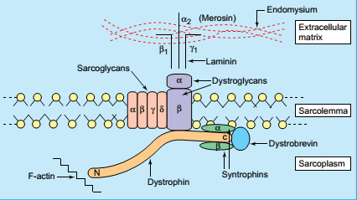
Progressive muscular dystrophy
Definition:
It is a group of genetically determined primary inherited, progressive degenerative disorders of muscles characterized by muscular weakness and wasting (myopathy).
Pathogenesis:
A defect in muscle fiber plasma membrane is leading to uncontrolled entry of calcium which activates calcium dependent protease that induces muscle fiber necrosis.
The missing gene product is a protein called Dystrophin.

Slide 21
Classification
Classification of the muscular dystrophy
X- linked recessive
 | Severe (Duchenne).
 | Benign (Becker).
 | Emery Dreifus
Autosomal recessive
 | Limb girdle (commonly)
 | Congenital muscular dystrophy
 | Distal myopthies
Autosomal dominant
 | Facioscapulohumeral.
 | Scapuloperoneal.
 | Oculopharyngeal.
 | Limb girdle (uncommonly)
 | Distal myopthies

Slide 22
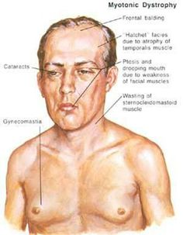
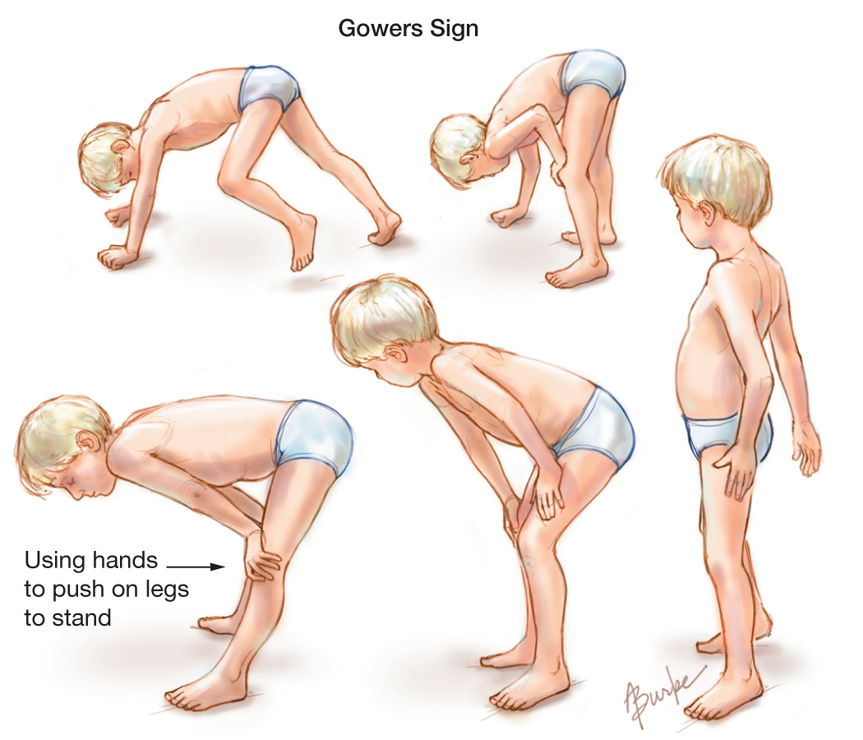

Slide 23
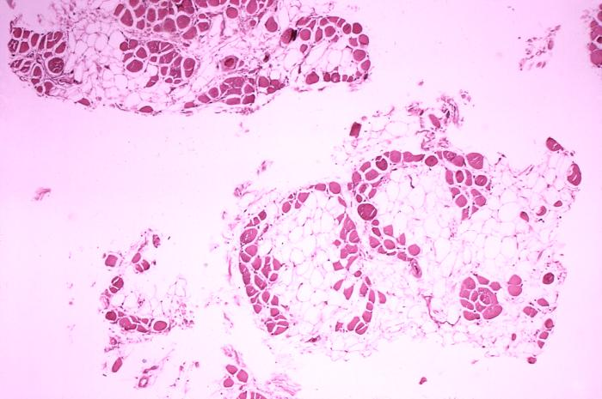
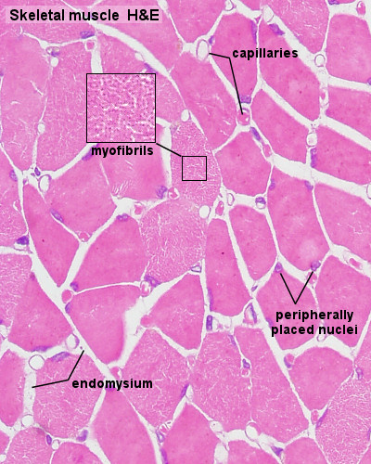
Pathology
The microscopic changes are the same in all types
Swelling of some muscle fibers.
Multiplication of sarcolemmal nuclei.
Striations become less marked.
Increased Connective tissue and fat deposition between the fibers will cause bulky muscle.
Later on, longitudinal splitting of muscle fibers and fibrosis.
Heart: May show cardiomyopathy.

Slide 24
Investigations for muscular dystrophies
EMG (electromyography): diminished duration and amplitude of motor action potential.
Urine: diminished creatinine and appearance of creatine.
Increase serum enzymes: used to detect female carriers and for preclinical diagnosis in males.
Muscle biopsy.

Slide 25
Treatment of muscular dystrophies
Long term treatment of steroids (prednisone): but risk exceeds benefit.
Myoblast transfer: will give a transient improvement (but cost exceeds benefit).
Calcium antagonists, Supportive therapy.
Assisted respiration when needed.
Psychological support.

Slide 26
Duchenne muscular dystrophy
Onset at 3-5 years
Initial symptoms: difficulty getting up from deep position and climbing steps, waddling gait
Weakness most pronounced in limb-girdle muscles, trunk erectors; craniobulbar muscles are spared
Skeletal deformities
Cardiomyopathy
Inability to walk by 9-11 years
Death occurs usually in the 3rd decade, from respiratory insufficiency

Slide 27
Myotonic dystrophy 1
Prevalence: 1 in 8000
Cause: CTG repeat expansion in a gene on chr. 19
Autosomal dominant inheritance, with anticipation
Multisystemic disease:
Myotonia: hyperexcitability of muscle membrane → inability of quick muscle relaxation
Progressive muscular weakness and wasting, most prominent in cranial and distal muscles
Cataracts, frontal balding, testicular atrophy
Cardiac abnormalities, mental retardation

Slide 28
Facioscapulohumeral dystrophy
Prevalence: 1 in 20,000
Autosomal dominant
Age of onset: infancy to middle age
Progressive muscular weakness and atrophy involving the face, scapular, proximal arm and peroneal muscles → myopathic face, winging of the scapula, inability to raise the arms, foot drop
Life span is not significantly affected

Slide 29
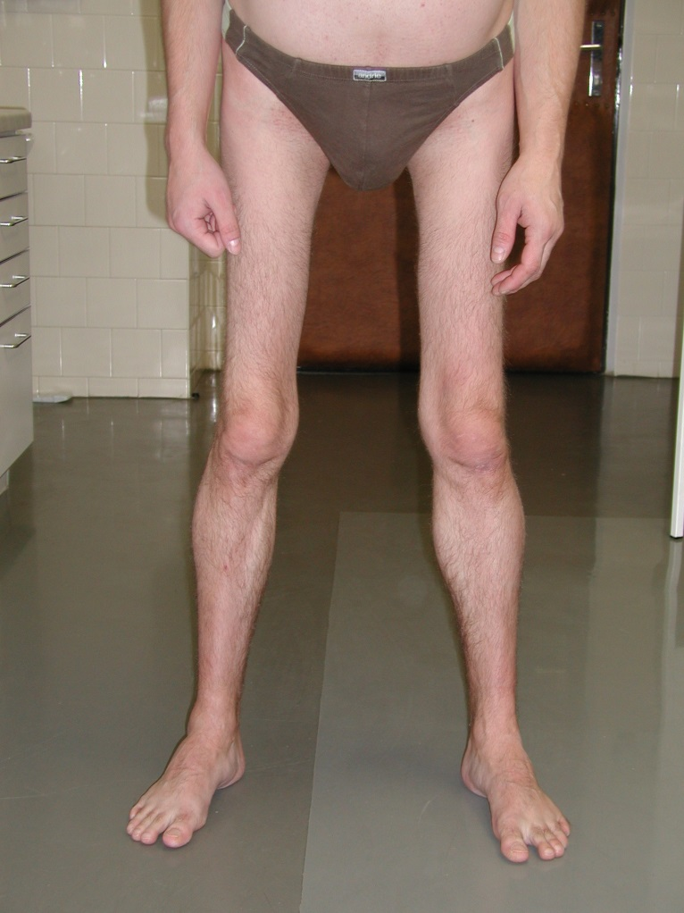
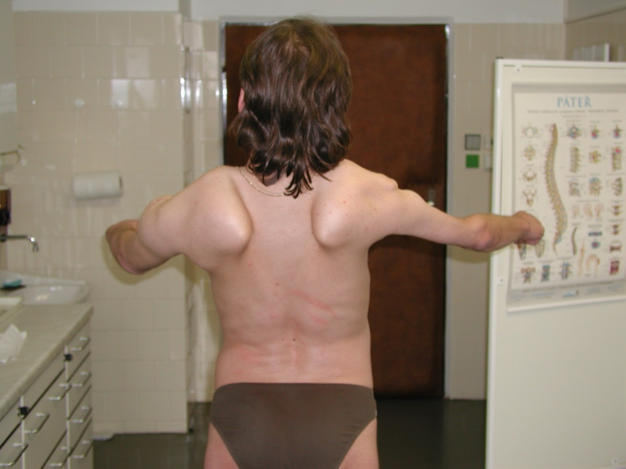

Slide 30
Inflammatory muscle diseases
Dermatomyositis
Polymyositis
Inclusion body myositis
Other systemic autoimmun diseases (SLE, Sjögren sy. etc.)

Slide 31
Dermatomyositis
Humorally mediated autoimmune disease affecting the muscles and skin (microangiopathy)
Symptoms progress over weeks, months
Rash on the face and neck
Periorbital oedema
Pain and weakness of proximal limb muscles, neck flexors
Dysphagia
Cardiac abnormalities, interstitial lung disease
Often paraneoplastic

Slide 32
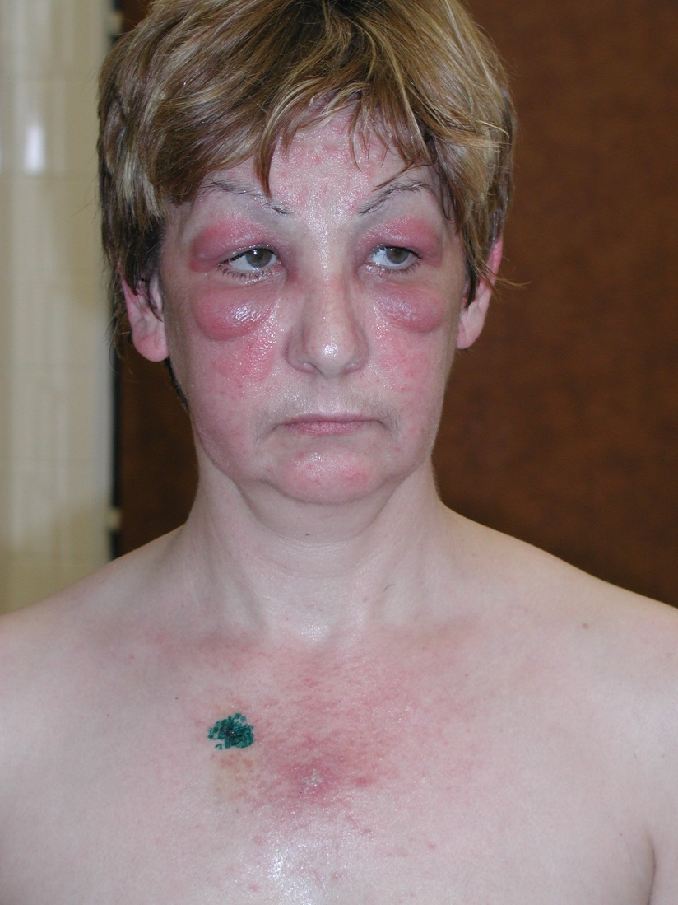
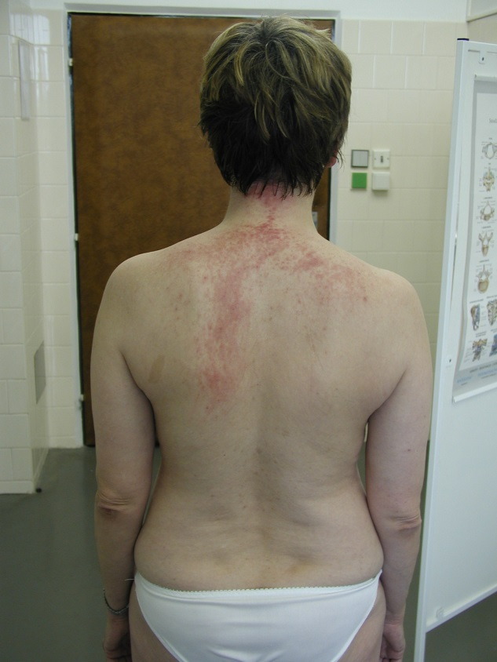
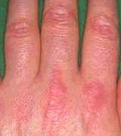
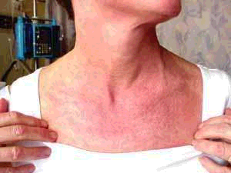

Slide 33
Management
Blood CK levels are elevated
EMG: myogenic findings
Muscle biopsy: inflammation
DM: perivascular infiltration, mainly in the perimysium
PM: endomysial inflammation
Therapy: immunosuppression, long-term treatment with corticosteroids (1 mg/kg/day)

Slide 34
Myasthenia Gravis
An autoimmune disease due to an antibody mediated attack directed against nicotinic AchR at neuromuscular junction
10% have thymoma and 70% have thymic hyperplasia
Incidence 1 : 20 000 in USA
Majority of the MG are young women in the third decade and middle aged men in 5th and 6th decade
Children account for 11% of all patients with MG

Slide 35
Clinical Features
Diplopia | 50-64%
Ptosis | 50-64%
Generalised | 35%
Leg weakness | 10%
Fatigue | 9%
Respiratory failure | 1%
Fluctuated muscle weakness and excessive fatiguability
Diplopia and ptosis
Bulbar weakness – swalloving, dysarthria
Generalized weakness of the trunk and extremities
MuSK-MG
Younger women
Predominantly facial, bulbar and respiratory weakness
Relatively mild limb weakness

Slide 36
Severity Classification

Slide 37
Diagnosis
Repetitive motor nerve stimulation
Stimulate motor nerve at 2-3 Hz and measure CMAP of stimulated muscle
Positive if >er 10% decrement in amplitude of CMAP from the 1st to the 5th potential
Positive in about 75% of patients with generalized MG, if
Proximal & clinically involved muscles are tested
Muscle is warm
More than one muscle is tested
Single fibre EMG
Tensilon test not recommended in pt suspected of being in crisis
False postive, false negative
Risk of worsening muscle weakness in pts with anticholinesterase overdose
Worsening of bulbar and respiratory symptoms in MuSK-MG

Slide 38
Myasthenic Crisis
Rapid and severe deterioration of the myasthenia itself, can bring the patient to the brink of respiratory failure and quadriparesis in a matter of hours
Respiratory infection or excessive use of sedatives or drugs blocking neuromuscular transmission may precede the myasthenic crisis, no cause could be determined in one-third

Slide 39
Commonly used drugs that worsen Myasthenia
Anticholinesterases can also lead to myasthenic crisis
Signs of excessive cholinergic activity
Miosis, diarrhea, salivation, abdominal cramps, sweating, weakness

Slide 40
Myasthenic Crisis
Treatment of Myasthenic Crisis
Careful intubation followed by mechanical ventilation in a CCU that is equipped to attend to the medical and neurologic needs of such patients.
Respiratory failure : by the use of bilevel positive airway pressure (BiPAP)
Anticholinergic drugs, which exaggerate secretions, are best withdrawn at the time of intubation

Slide 41
Myasthenic Crisis
Plasma exchange or IVIG a week or more is required for recovery.
It is best to wait 2 or 3 weeks before committing a patient to tracheostomy.
When weaning is anticipated, anticholinesterase agents are reintroduced slowly, and treatment with corticosteroids can be instituted if necessary.
Outcome
Duration of intubation : 13 days Tracheostomy 40%
Duration of hospitalization : 35 days Mortality 4%

Slide 42
Guillain-Barre Syndrome

Slide 43
GBS
Most common cause of acute and subacute generalised paralysis
Incidence of 0.4 to 1.7/100 000 per yr
Worldwide, all ages, both sexes
Preceding mild resp or GI infection in 60% (1-3 wks)
Campylobacter jejuni (26%),
CMV, EBV, VZV ,Influenza, cocksackie, hepatitis A ,B, HIV
May also be preceded by: Surgery and Immunisations

Slide 44
GBS:Typical Symptoms & Signs
Sensory
Paresthesias and slight numbness distally
Reduced proprioception and vibration sense (1 wk)
Motor
Weakness
Evolves symmetrically over days to 1-2 weeks
Usually LE before UE, proximal + distal
+/- trunk, intercostal, neck, cranial muscles
Progresses to total motor paralysis and respiratory failure in 5% of cases

Slide 45
GBS:Typical Symptoms & Signs
Reflexes
Reduced and then absent
Autonomic dysregulation
Sinus tachycardia/bradycardia, facial flushing, labile BP, excess or loss of sweating, urinary retention
Usually do not persist for >er 1 wk
Other
Myalgias (50%) in hips, thighs, calf, back

Slide 46
Variants
Fisher syndrome
Ophthalmoplegia, ataxia, areflexia
+/- bilateral facial nerve paresis
Associated with anti-GQ1b Ab
Acute motor sensory axonal neuropathy (5% of GBS cases)
Severe and diffuse axonal damage
Abrupt and explosive onset
Severe paralysis, minor sensory features
Slow and poor recovery
Pandysautonomia
Severe orthostatic hypotension, anhidrosis, dry eyes and mouth, fixed pupils, arrhythmia, bowel/bladder dysfunction
Areflexia without somatic motor/sensory involvement
Other variants:
Initial cervico-brachial-pharyngeal muscle involvement
Generalised ataxia without dysarthria or nystagmus
Facial and abducens weakness, distal paresthesias, proximal leg weakness

Slide 47
Laboratory Findings
CSF
Normal pressure
Protein
Early (1st 2 days): Usually normal (>85%)
Later: High (66% in 1st week, 82% in 2nd week)
Amount not correlated with clinical course or prognosis
Acellular or few lymphocytes
10% : 10-50 lymphocytes, decreases over 2-3 days; if not: other Dx
Oligoclonal bands (10-30%)

Slide 48
Laboratory Findings
EMG
Abnormalities seen within first week
Reduction in motor amplitude
Slowed conduction velocities
Conduction block in motor nerves
Prolonged distal latencies (distal conduction block)
Prolonged/absent F-responses (involvement of proximal parts of nerves and roots)

Slide 49
Diagnostic Criteria
National Institute of Neurological Disorders and Stroke (NINDS) criteria are based on expert consensus.
Required features include:
Progressive weakness of more than one limb, ranging from minimal weakness of the legs to total paralysis of all four limbs, the trunk, bulbar and facial muscles, and external ophthalmoplegia
Areflexia. While universal areflexia is typical, distal areflexia with hyporeflexia at the knees and biceps will suffice if other features are consistent.
Supportive features include:
Progression of symptoms over days to four weeks
Relative symmetry
Mild sensory symptoms or signs
Cranial nerve involvement, especially bilateral facial nerve weakness
Recovery starting two to four weeks after progression halts
Autonomic dysfunction
No fever at the onset
Elevated protein in CSF with a cell count <10 mm3
Electrodiagnostic abnormalities consistent with GBS

Slide 50
Differential Diagnosis
Features suggesting another diagnosis:
Sensory level, severe bladder or bowel dysfunction → Spinal cord syndrome
Marked asymmetry → Mononeuritis multiplex/vasculitis
CSF pleocytosis → Infectious disorders: viral, HIV, lyme, poliomyelitis
Very slow nerve conduction velocities, multiple relapses or chronic course -> CIDP
Persistent abdominal pain and psychiatric signs → Acute intermittent porphyria

Slide 51
Management
General:
Recommend admission for observation
Can deteriorate rapidly in first days of presentation
M&M: Respiratory failure, dysautonomia
25% will require mechanical ventilation
Respiratory
Measure MIP/MEP/FVC
Decision to intubate should be based on downward trend
Other measures of respiratory status same
Counting to 20, strength of NF

Slide 52
Course and Prognosis
Progressive symptoms : 1-4 weeks
Plateau: 2-4 weeks
Recovery: A few weeks to months
Recurrence: 5-10%
Mortality
3-5%
Cardiac arrest, ARDS, PTX, HemoTX, PE
Pronounced disability: 10%
Clinical prognostic indicators
Greater age
Rapid evolution; early and prolonged ventilatory assistance, rapid course
Lack of treatment with IVIG or plasma exchange
Laboratory
EMG: severely reduced CMAP and widespread denervation

Slide 53
Management
Dysautonomia
10% develop hypotension
Volume, +/- pressors
Hypertension
IV labetolol
Other complications
Adynamic ileus, PE,Aspiration

Slide 54
Management
PLEX and IVIG
No difference in efficacy between the two
Indications for prompt initiation
Respiratory failure
Bulbar involvement
Inability to walk without assistance
Usually see these signs day 5-10
May occur anywhere from day 1 – week 3
Steroids
No proven benefit

Slide 55
Management: IVIG
Dose: 0.4 gm/kg/day x 5 consecutive days
Easier to administer
Rare complications
Renal failure, proteinuria, pulmonary edema
Asceptic meningitis
Anaphylaxis in IgA deficiency

Slide 56
Management: PEX
Regimen: 4-6 (2L plasma)treatments on alternate days
Established usefulness in evolving phase
If treated within 2 wks onset
Decrease in LOS, ventilation, time to independent ambulation by approx. half
Value less clear if started later than 2 wks after initial symptoms
Predictors of response
Age
Preservation of motor CMAP amplitudes pre-PLEX

Slide 57
Motor Neuron Disease

Slide 58
Motor Neuron Disease
MND involves all diseases that involve selective loss of function of the upper and / or lower motor neurons innervating the voluntary musculature of the limbs and bulbar regions.

Slide 59
CLASSIFICATION
UMN
LMN
UMN + LMN
Proximal hereditary motor neuronpathy
ALS
PLS
Hexosaminidase deficiency
Sporadic
Adult onset
Juvenile onset
HSP
SMA
MMN
Neurolathyrism
Acute infantile
Intermediate & chronic childhood
Adult onset
Post-polio syndrome
Konzo
Post-irradiation syndrome
Hereditary bulbar palsy
Focal, monomelic SMA
With deafness
Without deafness
X linked bulbospinal neuronpathy
Hopkins’ syndrome

Slide 60
Amyotrophic Lateral Sclerosis ALS
Loss of motor neurons in the cortex, brainstem and spinal cord
Mix of upper motor neuron and lower motor neuron findings
Weakness, atrophy, fasciculations
Slurred speech, difficulty swallowing, shortness of breath
Can start in any extremity or the bulbar musculature
Relentlessly progressive

Slide 61
Amyotrophic Lateral Sclerosis ALS
50 % dead in 3 years, 80% dead in 5 years, 5-10% live more than 10 years
Death usually from respiratory failure
Etiology still only theoretical
Excess glutamate
Oxidative stress
Free radicals
Mitochondrial dysfunction
5-10% have inherited disease (SOD-1) gene defect 20%

Slide 62
Treatment in ALS
Riluzole
Antiglutamate agent (50 mg bid)
Modest benefits (decrease need for tracheostomy 56.8% after 18 months vs 50.4% for placebo
Only agent with proven efficacy
- Adverse effects; asthma, nausea,Dizziness, granulocytopenia, increase liver enzymes
Trophic factors, immunosuppressants, vitamins E & C
Supportive care

Slide 63
Treatment in ALS : Symptomatic
1. SIALOORHEA
Amitriptyline, Benzotropine, Trihexaphenidyl HCL
Transdermal hyoscine (scopalamine)
Propranolol decrease thick mucus production
Physical measures:
Suction machine
Manual assisted coughing techniques
In-Exsufflator cough machine
External beam irradiation to a single parotid gland

Slide 64
Treatment in ALS : Symptomatic
NUTRITION & DYSPHAGIA
Modification of the food & fluid consistency
Coaching by speech pathologist
PEG
RESPIRATORY INSUFFICIENCY
Non invasive vetillatory support
Respiratory therapist consultation
Ventillatory assisted respiration

Slide 65
Treatment in ALS : Symptomatic
ANTI- SPASTISITY
Baclofen Tizanidine Diazepam Dantrolene
Streching-exercise
FASCICULATION
Lorazepam, Decrease caffeine &nicotine intake
PAIN
NSAIDs Anticonvulsant Tegretol, Phenytoin
Tricyclic antidepressant

Slide 66
Summary

Slide 67
Localisation of the Disorders
Level of motor unit | Key Clinical Feature
Motor neuron | Predominantly motor signs Often asymmetric Occasional sensory signs DTRs may be increased if ALS
Peripheral nerve | Weakness and sensory signs +/- autonomic signs +/- cranial muscles DTRs reduced or lost

Slide 68
Localisation of the Disorders
Level of motor unit | Key Clinical Features
Neuromuscular junction | Involve cranial, limb girdle, proximal muscles +/- respiratory muscles Normal sensation (If presynaptic: +ve autonomic signs and post-exercise increase in strength If post-synaptic: fatigability)
Muscle | Predilection for neck, limb girdle, proximal muscles Normal sensation Possible cardiomyopathy Occasional resp muscle involvement Possible risk of myoglobinuria

Slide 69
Localisation of the Disorders

Slide 70
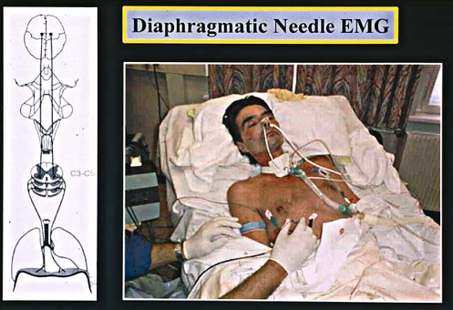
EMG of the diaphragm.
Left side shows the anatomic course of the nerve. The right side shows the position of the patient and examiner during the EMG

Slide 71
Thank YOU

